Slide 1
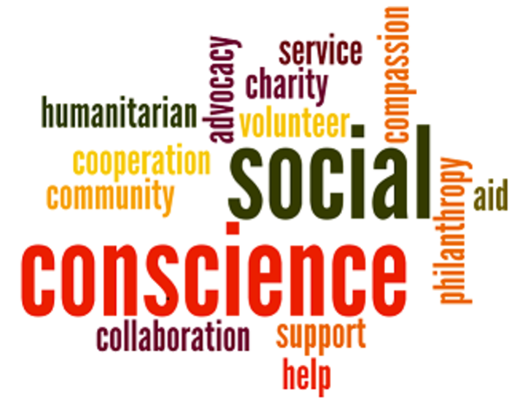
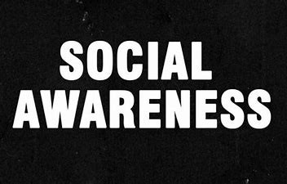
Name:-Gyanendra nath shukla
Regd.:-12113311
Roll No:-RK21RBA01

Slide 2
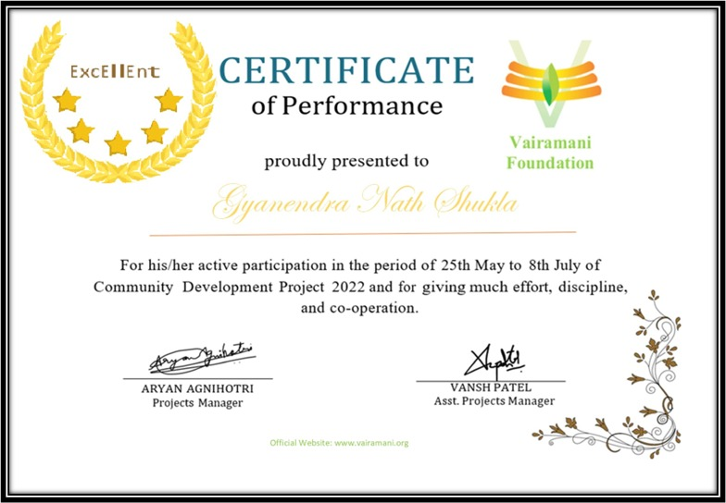

Slide 3
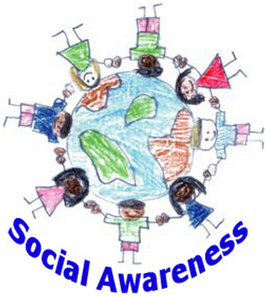
Introduction
The meaning of Social Awareness is to empathetically consider the perspectives of those around a person and apply that knowledge to guide an individual's choice of words and actions within a specific social situation. This lens of social awareness will bring about a more cohesive, positive interaction between an individual and their surroundings.
Social awareness is a skill that is developed during childhood and perfected as an individual ages.

Slide 4

PEROBLEM IDENTIFICATION

Slide 5
We are social creatures, and we live in a world where relationships and social interactions play a large part in a successful life. This makes having the ability to understand the emotions of others incredibly important.
If we have lack of social awareness, then it can cause our lives to be much more difficult and full of friction.
It’s not that social awareness all of a sudden will make us a social butterfly, it simply means we will relate to our fellow man or woman in a more positive and meaningful way. We will have a better time understanding their struggles and what makes them joyful.
The ability to relate to others is significant in creating rapport and building strong bonds.
What I would like to do is break down some of the key benefits you can expect from high social awareness.

Slide 6
OBJECTIVE TO BE ACHIEVED

Slide 7
I think the main objective of my Community Development Program is working to make people aware from various problem in a community which himnders childrten’s growth, education and health.
Community program is interested in all aspects of a community . The development is necessary in these places as a whole in Food facilities, eduction, health and welfare of people.
Different problems faced by community people may be solved by starting of such programs in the affected areas. The community also give hand to government for help them in development and growth.
Programs are working for the motivation of community people. Social organizers are employed in various sectors for their arousal and working for community welfare and betterment of humanity.

Slide 8
STEPS TAKEN TO ACHIEVE THE OBJECTIVE

Slide 9
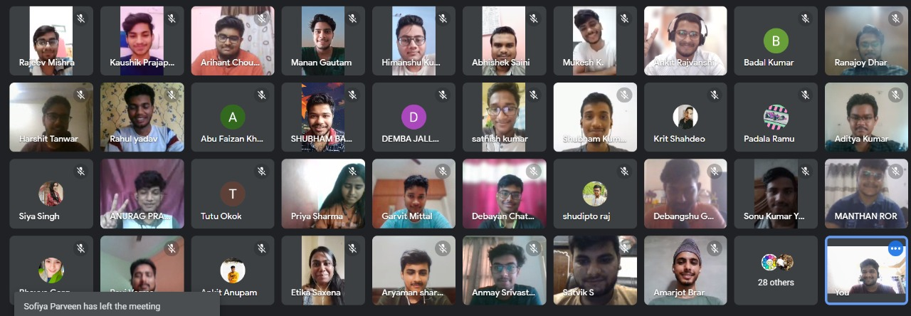
This community development project aims to aware people about many social problems. I took decision to work with Vairamani Foundation as a volunteer. I joined the team and helped several communities to fight in this critical situation. The main work of our team was to spread social awareness through our various skills such as blogs writing, through various poster, efficacious Videos.
Vairamani divided all the members in various teams to handle different aspects of our work. I was assigned work to advertise the blogs, posters, videos through social media and other platforms , and distribute food to needy people through the funds generated by us. Blogs, or Web logs, are online journals that are updated frequently, sometimes even daily. An update, (also called an entry or a post) is usually quite short, perhaps just a few sentences, and readers can often respond to an entry online. TPCs arrange various meetings on a daily basis to support and guide us, and planting many types of plants.

Slide 10
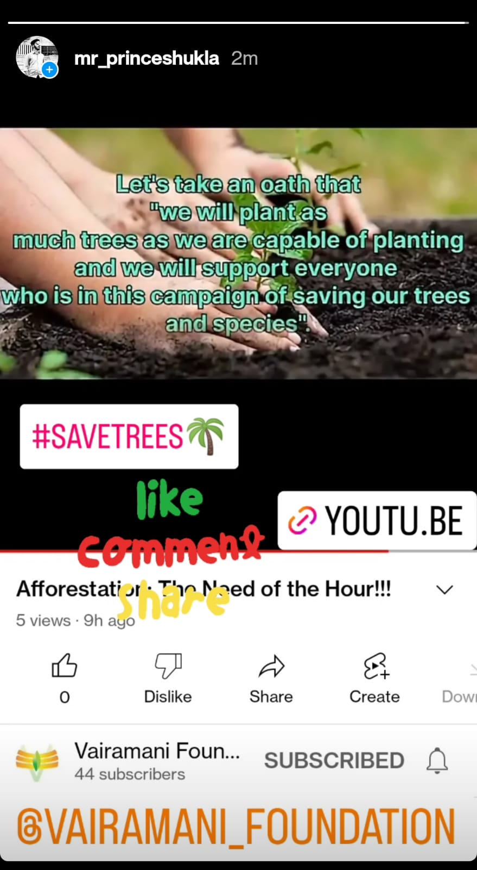


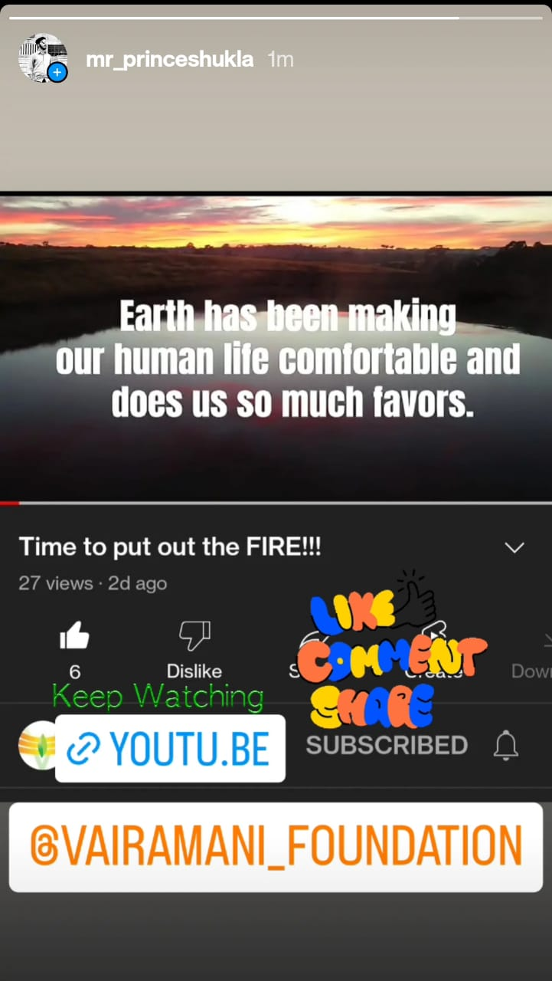
Awareness using Social Media:-
Now a day social media has become a main part of our daily routine. People spend their a lots of time on many social media platforms So we decided to make post of blogs, posters and videos related to many problems of our society on many platforms. On this way many people has seen these posts and learnt a lesson.

Slide 11
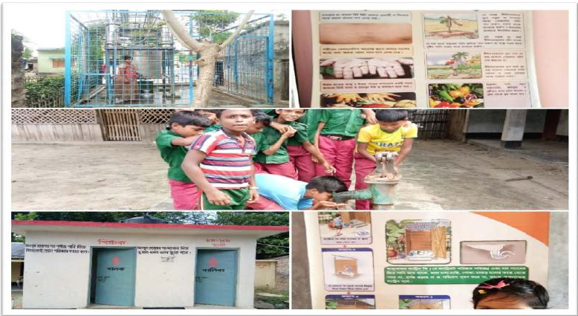
Visiting people:-
Our team has been visited to many villages, backward areas, Where we gathered villegers for many purposes regarding their necessities. To children we taught about importance of education, inspired them to go to school, colleges for study so that they can develop his society and make better their further generation.
To old people we told importance of regular excerises so that they can live very well without depending on pills and also about to keep our environment neat and clean.In this sequence we requested them to control the population and also told how can they effect of population on our society.

Slide 12
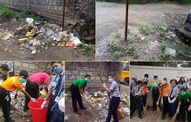
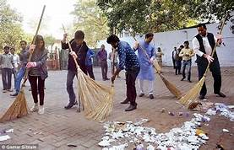
Cleanness :-
Cleanness is very essential things for our society and environment . It can help to save us from many fatal diseases and make our life joyful. For this we have provided then many safety things like-shop, sanitaizer, hand washes and also told How to use it, How to clean his houses, Latrines and other places.

Slide 13
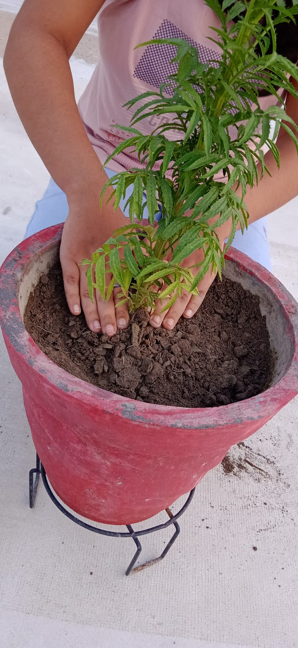
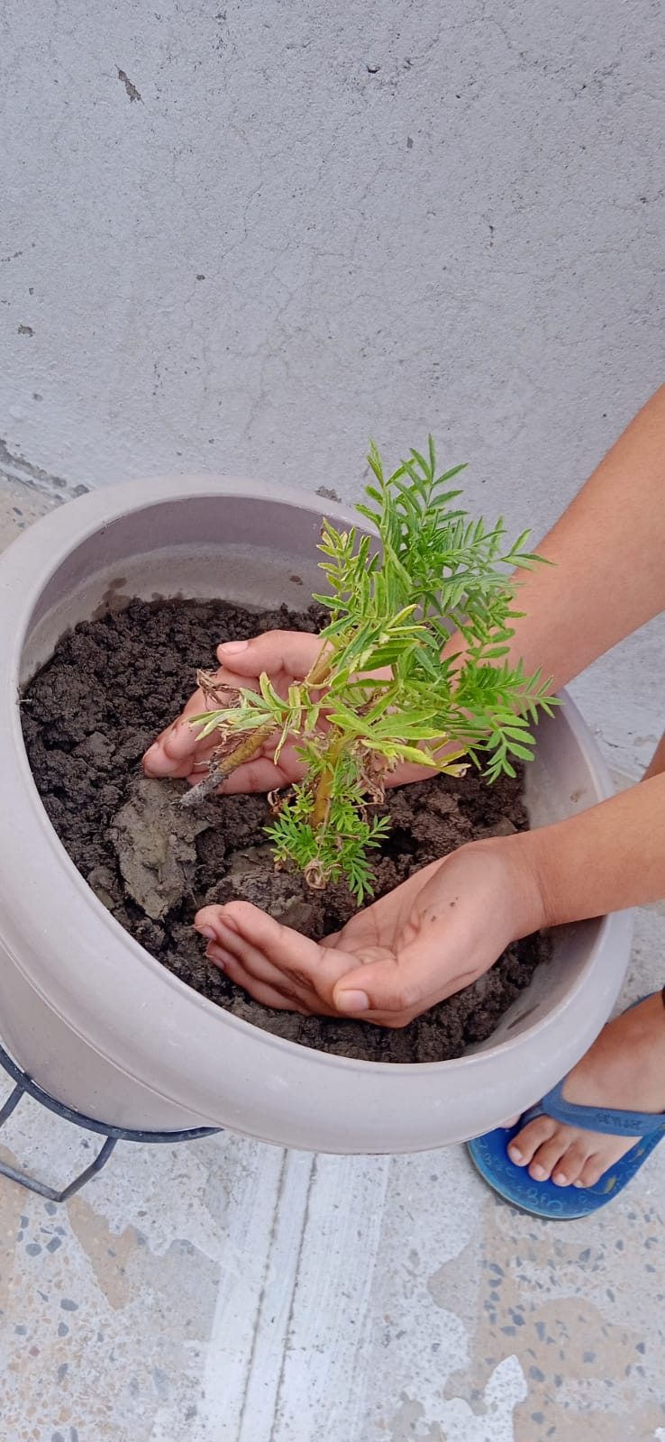
Plantation:-
As we all know that without trees life is not possible. Trees produces oxygen gas what is the most important things for human as well as all the creatures and absorves most dangerous gas Carbon di Oxide, and also helps in raining. Now a days due to population deforestation is happening at large scale So regarding this problem we have inspired them to plantation in very large amount and to stop cutting trees

Slide 14
EFFECTIVENESS OF THE PROJECT

Slide 15
Successful implementation of Social Awareness postulates will depend on all of society being engaged in the plan, and strong national and subnational coordination. To provide coordinated management of awareness , multidisciplinary coordination cell should be activated, with the engagement of relevant ministries such as health, finance, education, transport, public works, sanitization, environment, social protection and agriculture. National authorities should as matter of need, develop operational plan to spread awareness. Plans should include civil society and national NGOs to extend the reach of awareness. National plans should also be developed for the prevention and mitigation of the social impacts of the crisis, including areas of the response that disproportionately affect women and girls. Informed and empowered populations can protect themselves by taking measures at individual and community level that will increase the awareness. By contrast, misleading, ambiguous, and false information can have serious negative public health consequences, including by undetermining adherence to physical distancing measures and movement restrictions, promoting the hoarding and inappropriate use of essential supplies and equipment, and encouraging the inappropriate use of potentially dangerous or fatal curative and prophylactic measures without any evidence of benefit. In all the above, countries must ensure that communities, including the most hard-to-reach and vulner.

Slide 16
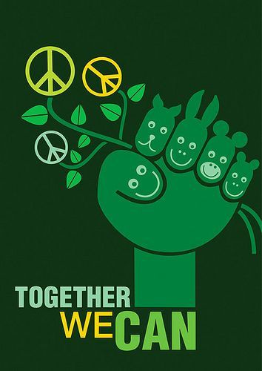
CONCLUSION
The purpose of the project is to spread social awareness among the people how to handle the problems emotionally and financially . In recent years, a number of social forces have changed community life and the expectation for young people. In Bangladesh main problem is poverty .People are living below poverty line. Children are deprived of basic education, they are having health issues, and they are not getting proper food. So now Bangladesh government is working to help her people. Besides that now a days NGO are working for helping those children. So they need volunteers, man power. Through community development project they are getting help by us. So we should contribute something to our community that will not make our community only but also the entire world.

Slide 17


